Slide 1
Classifying cats and dogs
Team 9

Slide 2
Overview
Features
Models
Old: color histograms
800 predictors
New: 11 features of 8 largest edge objects
88 predictors
Baseline: linear SVM
Advanced: gradient boosting model (GBM)

Slide 3
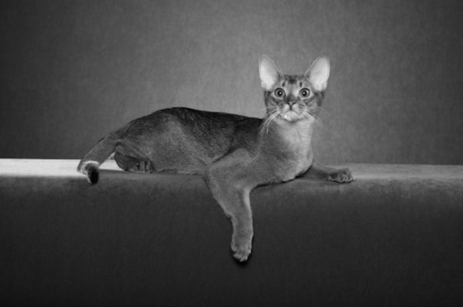
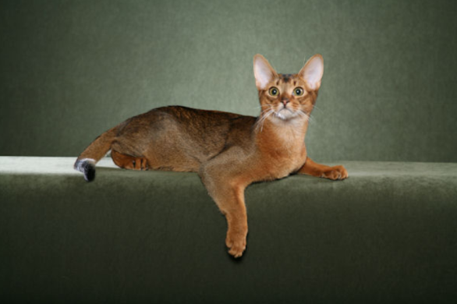

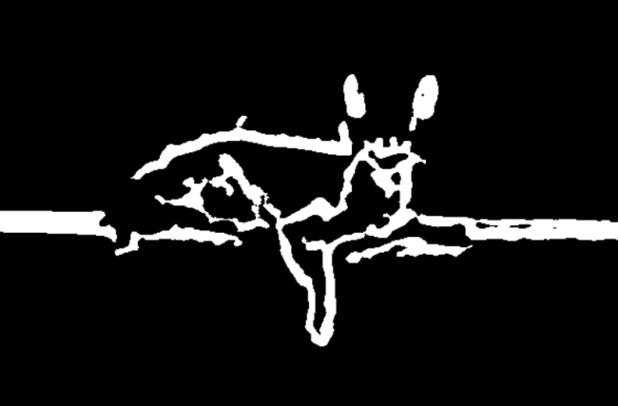
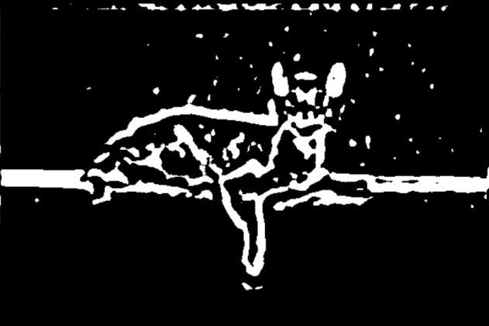
New Features
x = makeBrush(9, shape="gaussian", sigma=5)
x <- x / sum(x)
Img3<-filter2(img2,x)
Img2<-channel(img,’gray’)
subset
Img4<-thresh(img3)

Slide 4
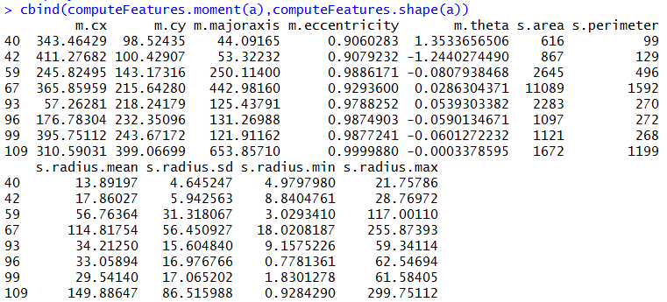

Slide 5
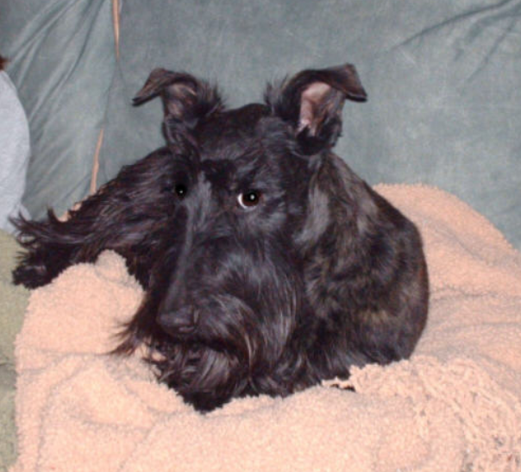
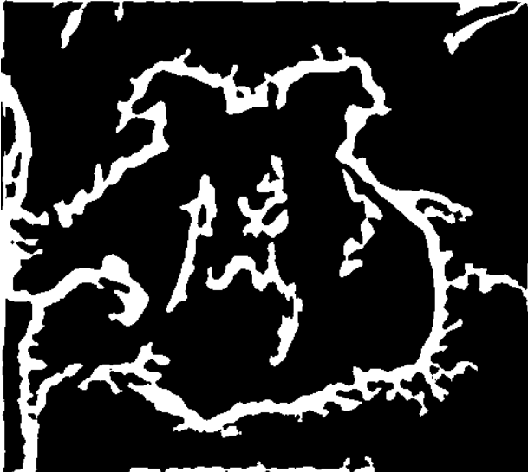
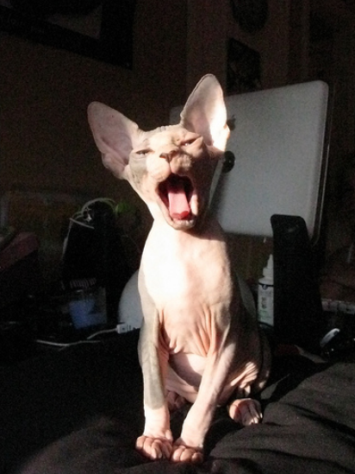
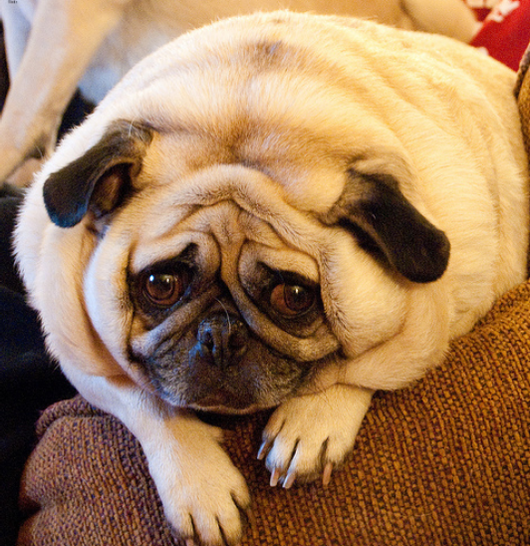
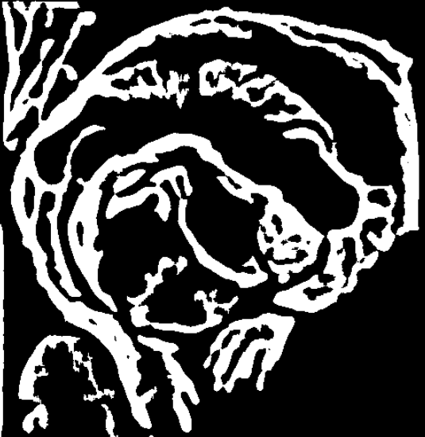
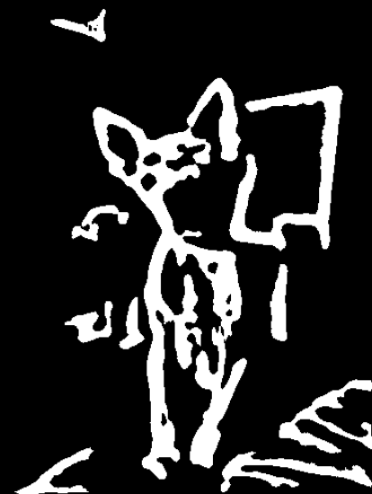

Slide 6
Baseline Model
Library(ksvm)
No tuning
Linear kernel (ie. kernel = "vanilladot“)
~10 minutes to run

Slide 7
Advanced Model
Library(gbm)
Used cross-validation for tuning
Number of trees: 1 to 500
Interaction depth: 1, 2, or 3
Minimum number of nodes: 10 or 50
Kept shrinkage (learning rate) at 0.1 b/c it will take too long to run with other values
~20 minutes to run

Slide 8
Results
Baseline w/ old features
Classify everything as dog
Train error: 32%
Test error: 33%
Adv w/ old features
Train error: 15%
Test error: 29%
Baseline w/ new features
Train error = test error = 46%
Adv w/ new features
Train error: 16%
Test error: 29%

Slide 9
Conclusion
New features: not that great
Advanced model: reduce test error by 17%

